Slide 1


IE685
Final Presentation for MSc-PhD Research Project 1
Title: An Empirical Study on Model fairness
Rishabh Agnihotri (22N0456)
Supervisor: Prof. Vishnu Narayanan
IEOR, IIT Bombay
Source: https://paperswithcode.com/paper/do-the-machine-learning-models-on-a-crowd

Slide 2
Outline
Motivation
Problem Statement
Background
Benchmark Selection
Experiment Design
Metrics used for experiment
Bias Mitigation Techniques
Unfairness in ML models (Findings)
Mitigation (Findings)
Conclusion
Future Work
Reference

Slide 3
Motivation
Do the Machine Learning Models on a Crowd Sourced Platform Exhibit Bias?
If yes, what are the different types of bias?

Slide 4
Problem Statement
What are the unfairness measures of the ML models in the model, and which of them are more or less prone to bias? (Unfairness)
What are the root causes of the bias in ML models, and what kind of techniques can successfully mitigate those bias? (Bias Mitigation)
What are the impacts of applying different bias mitigation techniques on ML models? (Impact)

Slide 5
Background
Basic idea of ML fairness is that, it should not discriminate between different groups.
From protected attribute class like age, sex, age, religion and so on.
One trivial idea is to remove protected attribute and use them in training.

Slide 6
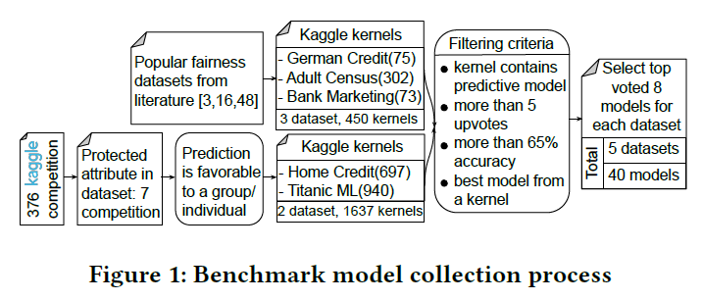
Benchmark Collection
Source: https://paperswithcode.com/paper/do-the-machine-learning-models-on-a-crowd

Slide 7
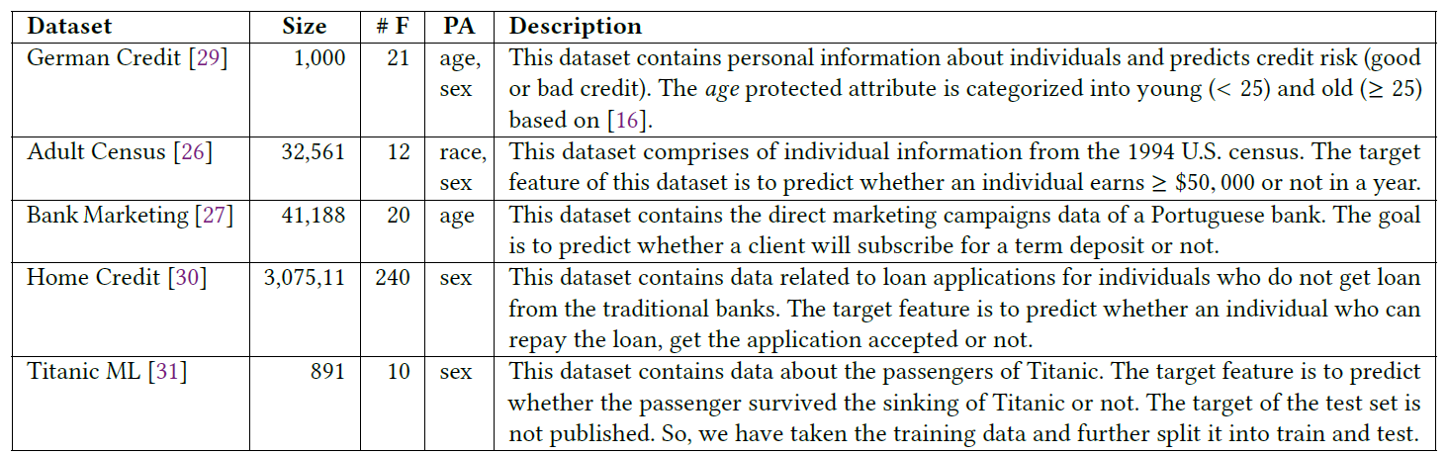
Benchmark Collection (contd…)
The datasets used in fairness experimentation:
#F: Feature Count. PA: Protected Attribute
Source: https://paperswithcode.com/paper/do-the-machine-learning-models-on-a-crowd

Slide 8
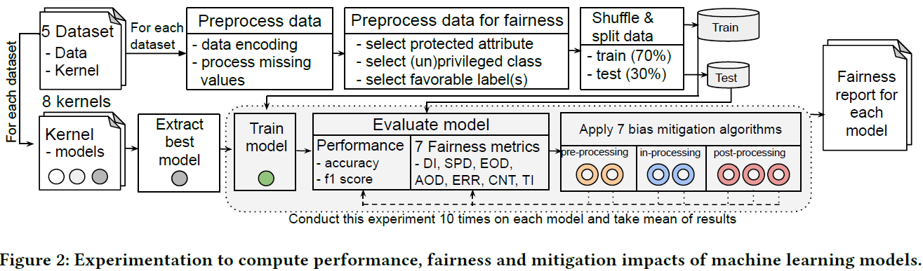
Experiment Design
Source: https://paperswithcode.com/paper/do-the-machine-learning-models-on-a-crowd

Slide 9
Metrics Used for experiment
Let D= (X,Y,Z) be a dataset, where “X” is training data , “Y” is the binary classification label, “Z” is the protected attribute.
Performance Measures:
Accuracy = (#True positive + #True negative)/#Total
F1 Score = 2*(Precision * Recall)/(Precision + Recall)

Slide 10


Metrics (contd…)
Fairness Measures:
Based on base rates:
Disparate Impact (DI) =
Statistical Parity Difference (SPD) =
Based on group conditioned rates:
Equal Opportunity difference (EOD):

Slide 11


Metrics (contd…)
Average Odds Difference (AOD):
Error Rate Difference (ERD):

Slide 12


Metrics (contd…)
Based on Individual Fairness:
Consistency (CNT) =
Theil Index (TI) =
where,

Slide 13
Bias Mitigation Techniques
Preprocessing Algorithms:
Reweighing: difference weights are assigned to reduce the effect of favouritism of a specific group.
DI Remover: measures fraction of individuals achieves positive outcomes from an unprivileged group in compare to privileged group.
In-processing Algorithms:
Adversarial Debiasing: It modifies the ML model by introducing backward feedback for predicting the protected attribute.
Prejudice Remover Regularizer: If ML models relies on decision based on the protected attribute, i.e. is called prejudice, for removing it simply remove protected attribute or regulate the effect in ML model.

Slide 14
Bias Mitigation Techniques (contd…)
Post-processing Algorithms:
Equalized Odds: This changes the output labels to optimize the EOD metric.
Calibrated Equalized Odds: This also optimizes EOD metric by using the caliberated prediction score produced by the classifier.
Reject Option Classification: It favours the instances in privileged group over unprivileged ones that lies in the decision boundary with high uncertainty

Slide 15
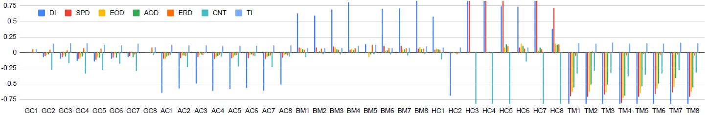
Unfairness in ML models
Source: https://paperswithcode.com/paper/do-the-machine-learning-models-on-a-crowd

Slide 16
Unfairness in ML models (Findings)
Model optimization goals seek overall performance improvement, which is causing unfairness.
Model GC1 exhibits the lowest bias among German Credit models.
GC6 is less fairer in terms of cumulative bias and individual metrics except ERD.
GC1 uses scoring= ‘recall’, whereas GC6 uses scoring= ‘precision’.
By using Random Forest classifier, and evaluate all metrics
After optimization the model for recall, observed that GC1 is more biased than GC2 in terms of ERD.

Slide 17
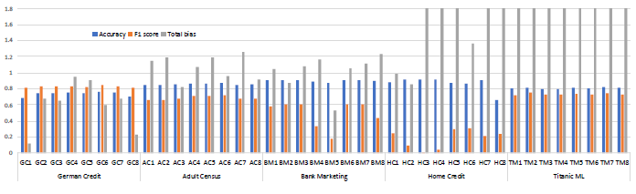
Unfairness in ML models (Findings)
Cumulative bias and performance of the models
Source: https://paperswithcode.com/paper/do-the-machine-learning-models-on-a-crowd

Slide 18
Unfairness in ML models (Findings)
2. Standardizing features before training models can help to remove disparity between groups in the protected class
3. Dropping a feature from the dataset can change the model fairness
4. Different metrics are needed to understand bias in different models
5. Libraries for model creation do not explicitly mention fairness concerns in model constructs

Slide 19
Mitigation (Finding)
1. Models with effective preprocessing mitigation technique is preferable than others.
2. Models with more bias are debiased effectively by post-processing techniques, whereas originally fairer models are debiased effectively by preprocessing or in-processing techniques.
3. When mitigating bias effectively, in-processing mitigation algorithms show uncertain behavior in their performance.

Slide 20
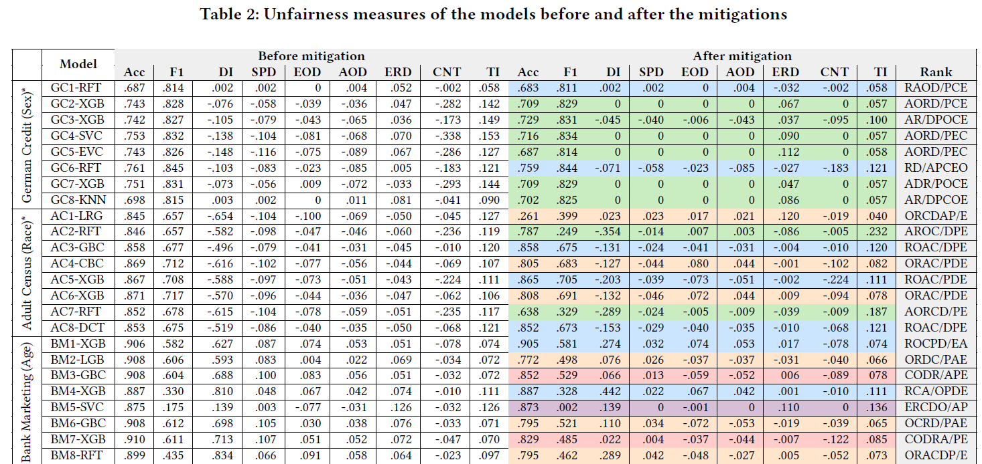
Mitigation (Finding)
Source: https://paperswithcode.com/paper/do-the-machine-learning-models-on-a-crowd

Slide 21
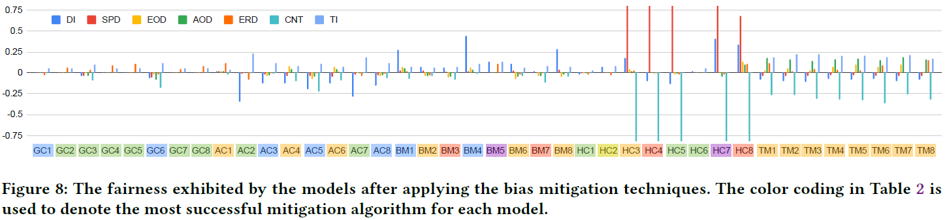
Mitigation (Finding)
Source: https://paperswithcode.com/paper/do-the-machine-learning-models-on-a-crowd

Slide 22
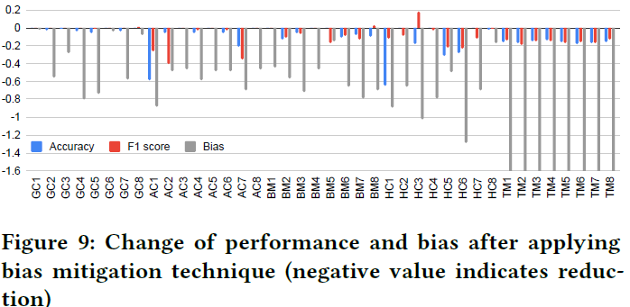
Mitigation (Finding)
Source: https://paperswithcode.com/paper/do-the-machine-learning-models-on-a-crowd

Slide 23
Conclusion
ML Fairness has received much attention recently
Created a benchmark of 40 ML models from 5 different problem
Used a comprehensive set of fairness metrics to measure fairness
Applied 7 mitigation techniques on models and computed fairness metric again
Also evaluated performance impact of the models after mitigation techniques are applied.

Slide 24
Future Work
In future research, further software engineering research and library enhancements are needed to make fairness concerns more accessible to developers.

Slide 25
Reference
https://paperswithcode.com/paper/do-the-machine-learning-models-on-a-crowd
Published in Sept. 2020 written bye Summon and Biswas, presented in Dept. of CS, Iowa University, USA.
Kaggle. 2017. Adult Census Dataset. https://www.kaggle.com/uciml/adultcensus- income. 19
Kaggle. 2017. Bank Marketing Dataset. https://www.kaggle.com/c/bankmarketing- uci.
Kaggle. 2017. German Credit Dataset. https://www.kaggle.com/uciml/germancredit.
Kaggle. 2017. Home Credit Dataset. https://www.kaggle.com/c/home-creditdefault- risk.
Kaggle. 2017. Titanic ML Dataset. https://www.kaggle.com/c/titanic/data.
Kaggle. 2019. Adult Census Kernel: Multiple ML Techniques and Analysis.
https://www.kaggle.com/bananuhbeatdown/ml-techniquesandanalysisofdataset.
Kaggle. 2019. Kernel: German Credit Risk Analysis. https://www.kaggle.com/pahulpreet/german-credit-risk-analysis-beginner-s-guide

Slide 26
Thank You

